Slide 1

Communication

Slide 2
What is communication?
Communication is the transfer and understanding of meaning.
Transfer of meaning- this means that if information or ideas have not been conveyed, communication hasn’t taken place.
The speaker who isn’t heard or the writer whose materials aren’t read hasn’t communicated.
For communication to be successful, the meaning must be imparted and understood.

Slide 3
Characteristics of communication
• Minimum two persons
• Two-way process
• Pervasive function
• Complete and rational process
• Continuous function
• Oral or written
• Formal or informal

Slide 4
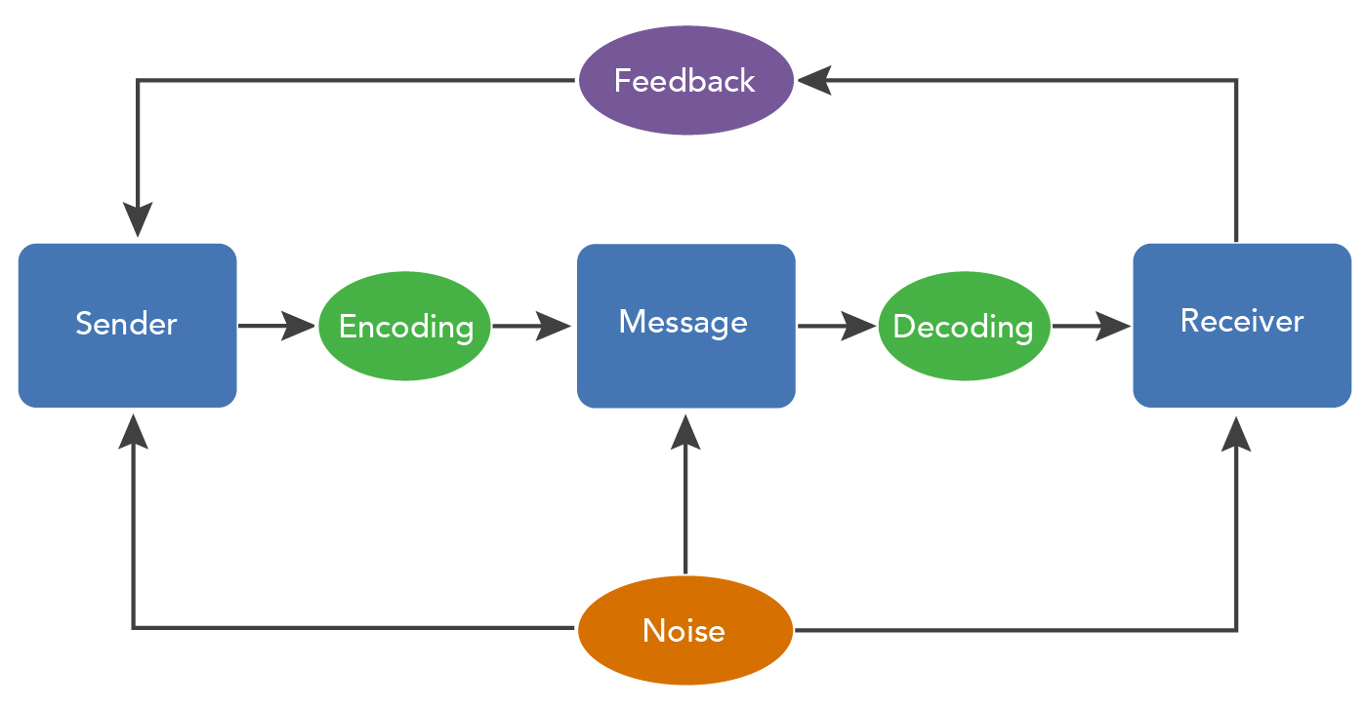
Communication Process

Slide 5
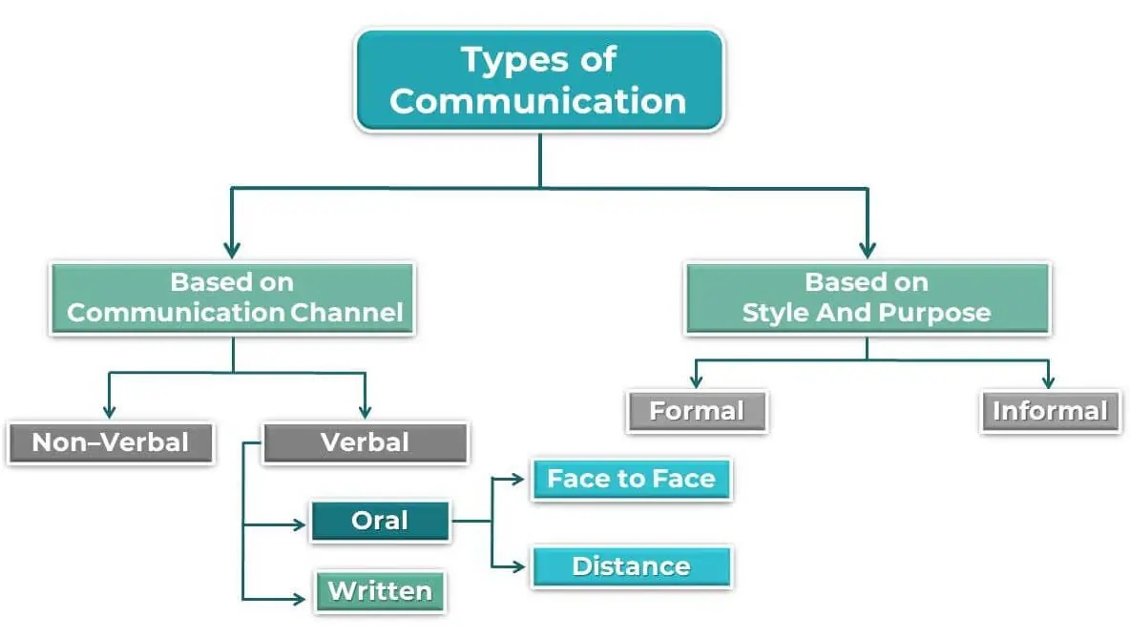

Slide 6
Communication styles of Men and Women
Some generalizations regarding communication styles of men and women have been made based on research and observations:
Direct vs. Indirect Communication:
Men: Generally tend to communicate more directly, focusing on conveying information and facts straightforwardly.
Women: May employ more indirect communication, often incorporating contextual cues and considering the emotional aspects of the message.
Emotional Expression:
Men: Traditionally, societal norms have encouraged men to suppress emotional expression, leading to more reserved or limited emotional communication.
Women: Are often more comfortable expressing emotions openly, including sharing feelings and empathy in communication.

Slide 7
Communication styles of Men and Women
3. Listening Styles:
Men: May prioritize problem-solving and offering solutions in conversations, sometimes interrupting to provide advice.
Women: Tend to engage in more active listening, offering empathy and support without immediately jumping to solutions.
4. Body Language and Nonverbal Cues:
Men: May exhibit more dominant or assertive body language, with gestures and postures that convey confidence and control.
Women: Often utilize more subtle nonverbal cues, such as facial expressions and tone of voice, to convey emotions and establish rapport.

Slide 8
Interpersonal skills
Interpersonal skills, often referred to as people skills or social skills, are the behaviors and abilities that enable individuals to interact effectively and harmoniously with others.
These skills are essential in both personal and professional settings and contribute to building positive relationships, fostering teamwork, and resolving conflicts.

Slide 9
Interpersonal Skills
Communication
Emotional Intelligence
Empathy
Conflict Resolution
Teamwork and collaboration
Adaptability
Leadership
Respect and professionalism

Slide 10
Interpersonal skills
Communication: The ability to express ideas, thoughts, and feelings clearly and effectively through verbal, non-verbal, and written means. Active listening, empathy, and assertiveness are also crucial components of effective communication.
Emotional Intelligence: The capacity to recognize, understand, and manage one's emotions, as well as the emotions of others. Emotional intelligence includes skills such as self-awareness, self-regulation, empathy, and social awareness.
Empathy: The ability to understand and share the feelings and perspectives of others, putting oneself in their shoes and demonstrating compassion and understanding.
Conflict Resolution: The skill of addressing and resolving conflicts or disagreements in a constructive and respectful manner. Conflict resolution skills include active listening, problem-solving, negotiation, and compromise.

Slide 11
5. Teamwork and Collaboration: Working effectively with others towards common goals, sharing responsibilities, and contributing to team success. This involves communication, cooperation, and the ability to work well in diverse teams.
6. Adaptability: The capacity to adjust to new situations, environments, and people, demonstrating flexibility and openness to change. Adaptability allows individuals to navigate different social contexts and handle unexpected challenges.
7. Leadership: The ability to influence and inspire others towards achieving common objectives, whether in formal leadership roles or informal settings. Leadership skills include communication, decision-making, delegation, and motivation.
8. Respect and Professionalism: Treating others with dignity, respect, and professionalism, regardless of differences in opinion, background, or role. Respectful communication, integrity, and ethical behavior are key aspects of maintaining positive interpersonal relationships.

Slide 12
Communication skills within an organizational context
1. Feedback Skills:
Constructive Feedback: Providing regular, constructive feedback helps employees understand their strengths and areas for improvement, fostering professional development and growth.
Performance Reviews: Feedback skills are essential during performance reviews, where managers assess employees' performance, provide feedback on their work, and set goals for improvement.
Peer Feedback: Encouraging peer feedback within teams promotes collaboration and allows team members to support each other's development.

Slide 13
2. Delegation Skills:
Task Assignment: Effective delegation involves assigning tasks and responsibilities to team members based on their skills, strengths, and workload capacity.
Empowerment: Delegation skills empower team members to take ownership of tasks, fostering a sense of responsibility and accountability.
Development Opportunities: Delegating tasks also provides opportunities for skill development and growth among team members.

Slide 14
3. Conflict Management Skills:
Resolution Facilitation: Conflict management skills are essential for resolving disagreements or conflicts that arise within teams or between team members.
Mediation: Managers or team leaders may act as mediators to facilitate constructive dialogue and find mutually acceptable solutions to conflicts.
Prevention: Effective conflict management skills also involve proactively identifying and addressing potential sources of conflict before they escalate.

Slide 15
4. Negotiation Skills:
Contract Negotiation: Negotiation skills come into play during contract negotiations with clients, vendors, or partners, where terms and conditions need to be mutually agreed upon.
Team Collaboration: Negotiation skills are also important for collaborating with team members to reach agreements on project timelines, resource allocation, and other team-related matters.
Conflict Resolution: Negotiation skills are valuable for resolving conflicts by finding compromises and solutions that address the interests of all parties involved.

